Slide 1

2.1Mathematical Preliminaries
Theory of Computation
王轩
Wang Xuan
*

Slide 2
Outline
1. Set
1.1. Set Definition
1.2. Set Operations
1.3. Properties of set operations
1.4. Cardinality and Power set
2. Relation
2.1. Equivalence Relation
2.2. Partial Ordering Relations
3. Functions
1

Slide 3
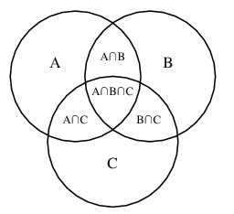
1.1 Set Definition
A set is a group of objects represented as a unit.
  Repetition don’t have meaning
  Don’t have sequence
Set is specified in three ways:
  list of elements in curly braces: A = {6, 12, 28}
  characteristic property: B = {x | x is a positive, even integer}
  Venn diagram
Set membership: (is [not] element of )
  a is element of A : 12 ∈ A
  b is not element of A: 9 ∉ A
Set Relations(Set inclusion):
  A ⊆ B (A is a subset of B) if every elements of A is also an element of B. E.x. {a,c} ⊆ {a,b,c} , {a,b,c} ⊆ {a,b,c}
  A ⊂ B (A is a proper subset of B) if A ⊆ B but B contains an element not in A. E.x. {a,c} ⊂ {a,b,c} , {a,b,c} ⊄ {a,b,c}
Venn Diagram
2

Slide 4
Definitions
Size
  |{a,b,c}| = 3
Infinite Sets :
  Infinite sets may be countable or uncountable.
Disjoint Sets :
  iff. A ∩ B = Φ, A and B are disjoint sets.
Cross Products:
  A × B = {(a,b): for all a ∈ A and b ∈ B} Note—"ordered" pairs
  Is it possible for A × B to equal B × A?
  E.x. A={1,2} , B={a,b,c}
    A × B = {(1,a),(1,b),(1,c),(2,a),(2,b),(2,c)}
3

Slide 5
1.2. Set Operations
Special Sets
  Empty Set ( Null Set) Φ , ∅ = {}
  Universal Set U
union: A ∪ B = {x :x ∈ A or x ∈ B}
intersection: A ∩ B = {x :x ∈ A and x ∈ B}
difference: A - B = {x :x ∈ A and x ∉ B}
Complement : ‾A = {x :x ∈ U and x ∉ A} (always with respect to Universe)
4

Slide 6
Example
Example：A = {6, 12, 28}, U = { 4,6,12,28,30 }
A ∪ {9, 12} = {6, 9, 12, 28}
A ∩ {9, 12} = {12}
A - {9, 12} = {6, 28}
A = { 4,30}
5

Slide 7
1.3. Properties of set operations
Idempotency :
  A ∪ A = A
  A ∩ A = A
Commutativity :
  A ∪ B = B ∪ A
  A ∩ B = B ∩ A
Associativity :
  (A ∪ B) ∪ C = A ∪ (B ∪ C)
  (A ∩ B) ∩ C = A ∩ (B ∩ C)
Distributivity :
  (A ∪ B) ∩ C = (A ∩ C) ∪ (B ∩ C)
  (A ∩ B) ∪ C = (A ∪ C) ∩ (B ∪ C)
Absorption :
  (A ∪ B) ∩ A = A
  (A ∩ B) ∪ A = A
DeMorgan’s Laws :
  A – (B ∪ C) = (A – B ) ∩ (A – C)
  A – (B ∩ C) = (A – B) ∪ (A – C )
6

Slide 8
1.4. Cardinality and Power set
The cardinality of a set, represented by |S|, is the number of elements in a set.
  Let S = {2, 4, 6}
  Then |S| = 3 or card(S) = 3
The powerset of S, represented by 2^{S}, is the set of all subsets of S.
  2^{S} = {{}, {2}, {4}, {6},{2,4}, {2,6}, {4,6}, {2,4,6}}
  The number of elements in a powerset is |2^{S}| = 2^{|S|}
7

Slide 9
2 Relation
T
d
f
3
b
1
S
e
R = { ( f ,2), ( d, 1 ), (a, 4) , (a, 5), (e, 2) }
A relation on sets S and T is a set of ordered pairs (s, t), where
  a) s ∈ S
  b) t ∈ T
  c) S and T need not be different
2
c
5
4
a
8

Slide 10
2.1 Equivalence Relation
A subset R of A×A is called an equivalence relation on A if R satisfies the following conditions:
  a) Reflexivity(自反性): (a, a) ∈ R for all a ∈ A ( we show a ≡ a )
  b) Symmetry(对称性): If (a, b) ∈ R, then (b, a) ∈ R, then (a, b) ∈ R
  c) Transitivity(传递性): If (a, b) ∈ R and (b, c) ∈ R, then (a, c) ∈ R
9

Slide 11
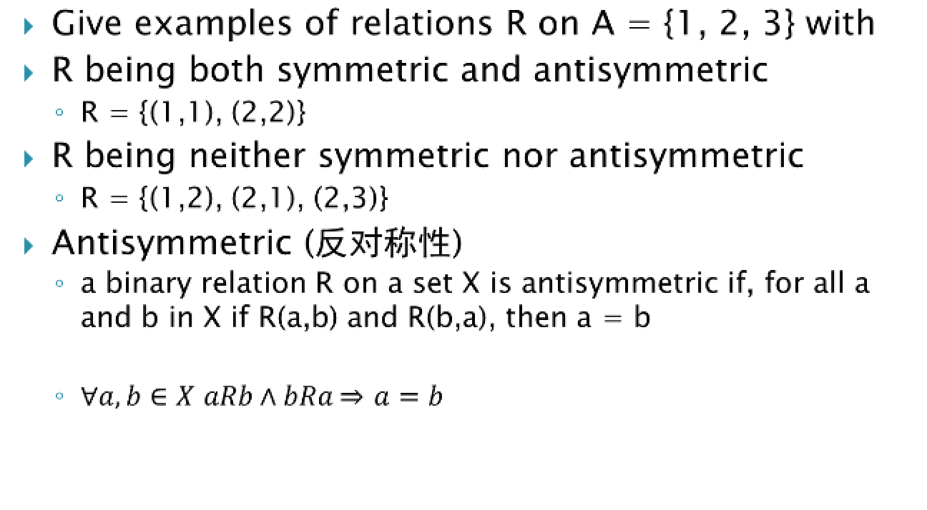
Antisymmetric
10

Slide 12
Example
Given the relation R in A as
- R = {(1,1), (2,2), (2,3), (3,2), (4,2), (4,4)}
Is R (i) reflexive (ii) symmetric (iii) transitive?
- i. R is not reflexive because 3 ∈ A but (3,3)∉R
- ii. R is not symmetric because (4,2) ∈ R but (2, 4) ∉ R
- iii. R is not transitive because (4,2) ∈ R, (2,3) ∈ R but (4,3) ∉ R
Is R antisymmetric?
-R is not antisymmetric because (2,3)∈R and (3, 2)∈R but 2≠3
11

Slide 13
Circular
Given a relation R is ‘circular’ if (a, b) ∈ R and (b, c) ∈ R ⇒(c, a) ∈ R. Show that a relation is reflexive and circular if and only if it is reflexive, symmetric, and transitive.
Left to right implication:
  (c, a) ∈ R, (a, a) ∈ R ⇒(c, a) ∈ R, since R is circular.
  (a, a) ∈ R, since R is reflexive.
  (c, a) ∈ R, (a, a) ∈ R and (c, a) ∈ R, Hence R is transitive.
  (c, a) ∈ R and (a, c) ∈ R, Hence R is symmetric .
12

Slide 14
Right to left implication:
  (a, b) ∈ R, (b, c) ∈ R ⇒(a, c) ∈ R, since R is transitive
  ⇒(c,a) ∈ R , since R is symmetric ⇒R is circular
  (a, c) ∈ R, (c, a) ∈ R ⇒ (a, a) ∈ R, since R is transitive
  ⇒R is reflexive
13

Slide 15
Example
For x, y ∈ N, x ≡ y (mod m) if and only if x – y is divisible by m, i.e. x - y = km, for k ∈ z.
Show that the relation “congruence(同余) modulo m” over the set of positive integers is an equivalence relation.
Let x, y, z ∈ N. Then
  x – x = 0 m⇒x ≡ x (mod m), for all x ∈ N. Therefore this relation is reflexive
  x ≡y (mod m) ⇒x -y = km , for integer k ⇒y –x = (-k)m ⇒y ≡x (mod m) Therefore the relation is symmetric
  x ≡ y (mod m) and y ≡ z (mod m) ⇒ x-y= km and y-z= lm for integers k,l. ⇒ (x-y)+(y-z) = (k+l)m ⇒ (x-y) = (K+l)m ⇒x ≡ z (mod m) since k+ l is also an integer. Therefore the relation is tansitive.
14

Slide 16
2.2 Partial Ordering Relations
A relation R on a set S is called a “Partial ordering” or a
“Partial order”, if R is
  Reflexive
  Antisymmetric
  Transitive
A set S together with a partial ordering R is called a “Partially ordered set” or “Poset”.
  Example: The relation ≤ on the set R of real numbers is reflexive, antisymmetric and transitive. Therefore ≤ is a “Partial ordering”.
15

Slide 17
Partition and Equivalence Class
Thus a partition P of S is a subdivision of S into disjoint nonempty sets
  S1∪ S2 ∪ …∪ Sn = S
  ∀ Si , Si≠ ∅
  ∀ Si, Sj, Si≠ Sj⇒ Si∩Sj= ∅
Then S1 ,S2 ,…,Sn is called a partition of S.
If R is an equivalence relation on a set S, for each ‘a’ in S, let [a] denote the set of elements of S to which ‘a’ is related under R, i.e.
[a] = {x : (a, x) ∈ R}
Here [a] is the Equivalence class” of ‘a’ in S.
16

Slide 18
3. Functions
f : S1 →S2
  Domain (f) ⊆ S1
  Range (f) ⊆ S2
  S1 may be same as S2
f is Total Function if Domain(f) = S1 else f is Partial Function
17

Slide 19
Kinds of Functions
One-to-One Function (Injection): A function f : A→ B is said to be one-to-one if different elements in the domain A have distinct images in the range.
  A function f is one-to-one if f (a) = f (b ) implies a = b .
Onto function (Surjection): A function f : A → B is said to be an onto function if each element of B is the image of some element of A.
18

Slide 20
One-to-one onto Function (Bijection): A function that is both one-to-one and onto is called a “Bijection”
Invertible function: A function f : A → B is invertible if its inverse relation f ^{–1} is a function from B to A.
A function f : A → B is invertible if and only if it is both one-to-one and onto.
19

Slide 21
Examples
Is f (x) = x² from the set of integers to the set of integers is one-to-one? Why?
No e.x. x = +1 , x= -1
Given f is a function f : A → B where A = {a, b, c, d} and B = {1, 2, 3} with f (a) = 3, f (b) = 2, f (c) =1, and f(d) = 3. Is the function f an onto function?
Yes
20

Slide 22
Review
Set Definition
Set Operations
Properties of set operations
Cardinality and Power set
Equivalence Relation
Partial Ordering Relations
Functions
Question?
21

Slide 23
Theory of Computation
2.2Deterministic Finite Automaton
王轩
Wang Xuan
*

Slide 24
Outline
Finite Automata
Formal Definition of DFA
Transition Diagrams
Recognizing Languages
Regular Languages
Union of Two Languages and proof
Concatenation of L₁ and L₂
1

Slide 25
Finite Automata
A Finite Automata (FA) is the most restricted model of computing that we will work with.
In a Finite Automaton (FA):
  Input is read once from left to right. ▪
  The input is often viewed as being stored/written on a tape. ▪
  There is no memory, except for one register (also called the finite control) that contains the state. ▪
  A FA has a fixed and finite number of states.
2

Slide 26
Formal Definition of DFA
A deterministic finite automaton is a 5-tuple.
M = (Q, Σ, δ,q₀,F)
  Q: finite set of states
  Σ: finite alphabet
  δ: transition function δ:Q×Σ→Q
  q₀∈Q: start state
  F⊆Q: set of accepting states
3

Slide 27
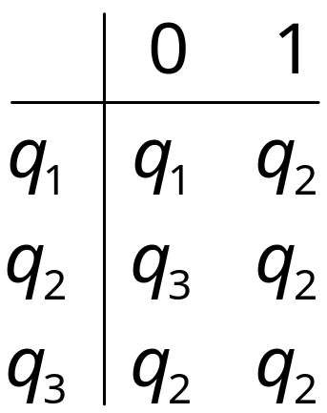
Transition Diagrams
Transition diagrams can be used to represent a DFA.
  The vertices are the states. ▪ ▪
  The short arrow points to the initial state. ▪
  The states with a double circle are the accepting states.
Matrix Representation
0
1
1
0
q₁
q₂
q₃
0,1
4

Slide 28
Finite Automata (cont.)
Consider the language that consists of all strings over {1, 0} that contain an odd number of 1’s.
Can we build an algorithm for accepting this language on a FA ????
5

Slide 29
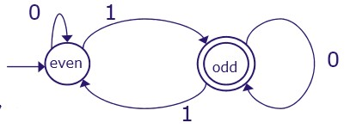
Specifying the Transitions
Functions  δ(even,0) = even;  δ(even,1) = odd;  δ(odd,0) = odd;  δ(odd,1) = even;
Tables:
Graphs
  Arrow from “nowhere” into initial state
  Double circle for “final” state
State\input | 0 | 0
even | even | odd
odd | odd | even
6

Slide 30
Recognizing Languages
A Finite Automaton M = (Q, Σ, δ, q, F) accepts a string/ word w = w₁… w_{n} if and only if there is a sequence r₀… r_{n} of states in Q such that:
  1) r₀ = q₀
  2) δ(r_{i},w_{i+1}) = r_{i+1} for all i = 0,…,n–1
  3) r_{n} ∈ F
If L is the set of strings that the automaton accepts, we write L(M)=L. 
We say that M recognizes L.
7

Slide 31
Language
The language accepted by a DFA M : (Q, Σ, δ, q₀, F) is the set of all strings on Σ accepted by M. 
In formal notation L (M) = {w ∈ Σ* : δ*( q₀,w) ∈ F } .
No acceptance means that the DFA stops in a non-final state.  L(M)= {w ∈ Σ* : δ*( q₀ ,w) ∉ F }
8

Slide 32
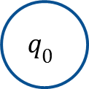



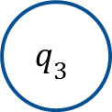
Example
Find a deterministic finite accepter that recognizes the set of all strings on Σ = {a, b} starting with the prefix ab.
a
b
a, b
b
a
a, b
9

Slide 33
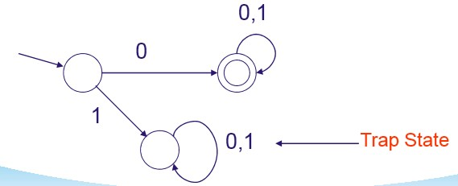
Trap State
Any words with prefixes that take you to a trap state will not be accepted 
Example: Machine accepting words over {0,1} that start with 0:
10

Slide 34
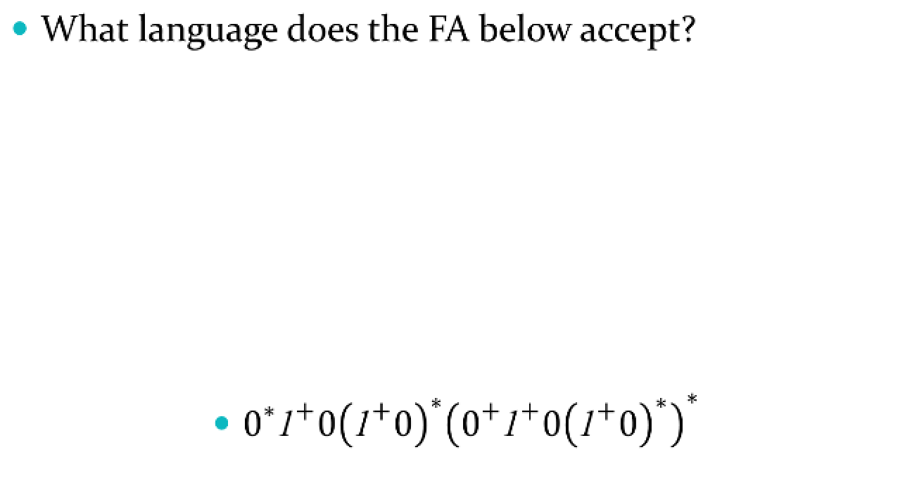
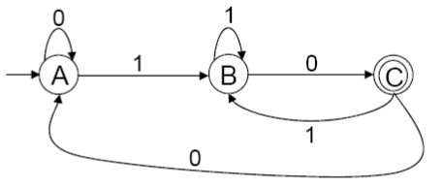
(cont.)
11

Slide 35
Regular Languages
Every finite automaton accepts some language. 
If we consider all possible finite automata, we get a set of languages associated with them.
We will call such a set of languages a family. 
A language L is called regular if and only if there exists some deterministic finite accepter M such that L = L(M)
To prove regular, give DFA accepting it
12

Slide 36
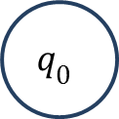



Exmaple
Show that the language L = {awa : w ∈ {a,b}* } is regular.
b
a
a
a
b
b
a,b
13

Slide 37
Union of Two Languages
If A₁ and A₂ are regular languages, then so is A₁ ∪ A₂. (The regular languages are ‘closed’ under the union operation. Theorem 1.45 in English Edition; theorem 1.12 in Chinese Edition)
Proof idea: A₁ and A₂ are regular, hence there are two DFA M₁ and M₂, with A₁=L(M₁) and A₂=L(M₂). Out of these two DFA, we will make a third automaton M₃ such that L(M₃) = A₁ ∪ A₂.
14

Slide 38
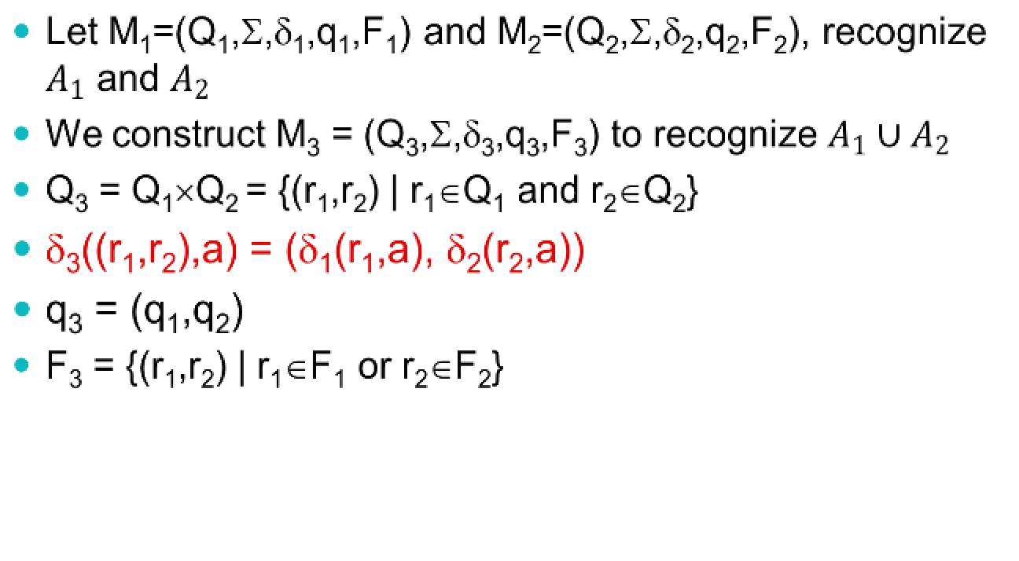
Proof Union-Theorem (1)
15

Slide 39
Proof Union-Theorem (2)
The automaton M₃ = (Q₃,Σ,δ₃,q₃,F₃) runs M₁ and M₂ in ‘parallel’ on a string w.
In the end, the final state (r₁,r₂) ‘knows’if w∈L₁ (via r₁∈F₁) and if w∈L₂ (via r₂∈F₂)
The accepting states F₃ of M₃ are such that w∈L(M₃) if and only if w∈L₁ or w∈L₂, for: F₃ = {(r₁,r₂) | r₁∈F₁ or r₂∈F₂}.
16

Slide 40
Concatenation of L₁ and L₂
Definition: L1• L2 = { xy | x∈L1 and y∈L2 }
Example: {a,b} • {0,11} = {a0,a11,b0,b11}
Theorem 1.13: If L₁ and L₂ are regular languages, then so is L₁•L₂. (The regular languages are ‘closed’ under concatenation.)
17

Slide 41
Can DFA prove this theorem?
To prove this theorem, let’s try something along the lines of the proof of the union case. As before, we can start with finite automata M1 and M2 recognizing the regular languages A1 and A2.
But now, instead of constructing automaton M to accept its input if either M1 or M2 accept, it must accept if its input can be broken into two pieces, where M1 accepts the first piece and M2 accepts the second piece.
The problem is that M doesn’t know where to break its input. To solve this problem we introduce a new technique called nondeterminism.
18

Slide 42
Review
Finite Automata
Formal Definition of DFA
Transition Diagrams
Recognizing Languages
Regular Languages
Union of Two Languages and proof
Concatenation of L₁ and L₂
19

Slide 43
Theory of Computation
2.3Nondeterministic Finite Automaton
王轩
Wang Xuan
*

Slide 44



非确定性有限状态自动机理论的开创者
1976 年度的图灵奖由当时在以色列希伯莱大学任教的米凯尔.拉宾（Michael O. Rabin）和在英国牛津大学任数理逻辑教授的达纳.斯科特（Dana Steward Scott）共同获得。拉宾和斯科特是师兄弟，两人在20世纪50年代中期先后师从著名的逻辑学家和计算机专家阿隆索.邱奇（Alonzo Church,他因与Curry 一起发明了λ-演算以及提出了“任何计算，如果存在一有效过程，它就能被图灵机所实现”这一被称为“邱奇论题”的命题而闻名于世），并在有限自动机及其判定问题的研究中进行合作，奠定了非确定性有限状态自动机的理论基础。之后，他们的研究方向不尽相同，拉宾侧重于计算理论，而斯科特侧重于逻辑学在计算机科学中的应用，在各自的领域中又分别获得重大成果，作出了创造性贡献。
米凯尔·拉宾
达纳·斯科特

Slide 45
非确定性有限状态自动机理论的开创者
拉宾1931年9月1日生于德国的布雷斯劳。他父亲是一名犹太教教士，也是一位博士；拉宾的母亲也是知识分子，有文学博士头街。纳粹布特勒上台以后，他们全家于1935年迁回巴勒斯坦，躲过了一劫。1948年以色列建国以后，他们成为以色列公民。
拉宾在濒临地中海的港口城市海法度过了他的童年和少年时代。一次他和比他高好几班的学生比试解欧几里德几何题，他赢了他们，这使他对数学产生了兴趣，因此，从莱利学院（Reali College）毕业以后，他进入希伯莱大学学习数学， 在那里，他通过数学家克林（S. C. Kleene,因提出不动点定理而闻名于世）所著的《元数学》一书首次接触到图灵关于可计算机的概念和图灵机这一理论计算模型，立即被深深吸引。 但为了打好自己的数学基础，他的硕士论文没有以此为课题，而选择了当时由德国女数学家埃米.诺特（Emmy Noether, 1882-1932）创立不久的抽象代数中关于可交换环理论中的一个问题。
获得数学硕士学位以后，拉宾去了美国， 因为20世纪50年代初，以色列建国伊始，经济与科技都还不够发达，很少有人研究计算这类问题，甚至连许计算机都没有。 拉宾到美国后，先在宾夕法尼亚大学攻读博士学位。拉宾的博士论文课题将他所熟悉的抽象代数和他感兴趣的可计算性问题联系在一起：群（GROUP）的可计算性问题。 拉宾的论文中证明了与群众有关的许多问题， 如群是否符合交换律等， 都是不能由计算机解答的。

Slide 46
非确定性有限状态自动机理论的开创者
但是使拉宾成名的并非其博士论文而是源于IBM研究中心于1957年向他和他的师弟斯科特提供的一份暑期工作。公司允许他们作他们感兴趣的任何工作，于是拉宾和斯科特就联手研究图灵提出的计算模型，也就是图灵机。图灵机是一种禁止往磁带上写的计算机，叫有限状态自动机(finite state automata，缩写FSA)。图灵在研究这种机器时的基本信条是：机器在输入相同时，其“心智状态”也相同，即对于具有给定指令集的机器而言，一定输入的机器总是按同一方式运行的。
拉宾和斯科特认为，这种具有“确定性”行为的机器带来了局限性。因此，他们定义了一种新的、“非确定性”的有限状态自动机(nondeterministic finite state automata，缩写为NDFSA)，这种机器在读取到一定的输入后，有一个可以进入的新状态的“菜单”可供选择，这样对给定的输入计算便不单一了，每个选择代表一种可能的计算。

Slide 47
非确定性有限状态自动机理论的开创者
拉宾和斯科特将图灵的有限状态自动机从确定性一种形态扩展到非确定性的另一种形态，极大地推动了有限状态自动机理论的发展。虽然非确定性有限状态自动机的能力并不比确定性的有任何增加(拉宾和斯科特自己已经证明，任何可以用非确定性机器解决的问题都可以在确定性机器上解决，而且提出了将非确定性机器转换为确定性机器的方法问题)，但是它可以简化机器描述和加快解题速度。后来的实践证明，非确定性有限状态自动机在机器翻译、文献检索和字处理程序等应用中都起了重要的作用。

Slide 48
Outline
Formal Definition of NFA
Recognizing Languages
Equivalence of DFA and NFA
Procedure: NFA-to-DFA
1

Slide 49
Why Non-Determinism?
An NFA can be converted to a DFA, so we can still build it
Easier to construct DFA to accept a given language (i.e. pattern matching, grep)
Multiple choices for same input/state pair, and possibly transitions with no input being “used up”
A nondeterministic finite automaton has transition rules/possibilities like
q₂
1
ε
q₁
q₂
q₁
1
q₃
2

Slide 50
A Nondeterministic Automaton NFA
0,1
0,1
1
0, ε
1
q₁
q₂
q₃
q₄
This automaton accepts “0110”, because
there is a possible path that leads to an
accepting state, namely:
q₁ → q₁ → q₂ → q₃ → q₄ → q₄
3

Slide 51
NFA (cont.)
0,1
0,1
1
0, ε
1
q₁
q₂
q₃
q₄
The string “1” gets rejected: on “1” the automaton can only reach: {q₁,q₂,q₃}.
The set reached doesn’t contain accept states.
4

Slide 52
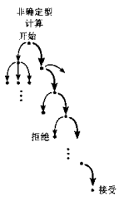
Nondeterminism ~ Parallelism
For any (sub)string w, the nondeterministic automaton can be in a set of possible states.
  One input with many possible outputs
If the final set contains an accepting state, then the automaton accepts the string.
“The automaton processes the input in a parallel fashion. Its computational path is no longer a line, but a tree.”
5

Slide 53
Formal Definition of NFA
A nondeterministic finite automaton (NFA) M is defined by a 5-tuple M=(Q,Σ,δ,q₀,F),
  Q: finite set of states
  Σ: finite alphabet
  δ: transition function δ:Q×Σ_{ε}→P (Q)
  The image of δ is an element of power set
  q₀∈Q: start state， F⊆Q: set of accepting states
6

Slide 54
Nondeterministic δ:Q×Σ_{ε}→P (Q)
The function δ:Q×Σ_{ε}→P (Q) is the crucial difference. It means: “When reading symbol “a” while in state q, one can go to one of the states in δ(q,a)⊆Q.”
  When it reads a in state q, it turns to a state in δ( q, a )
The ε in Σ_{ε} = Σ∪{ε} takes care of the empty string transitions.
  ε has no input，in another word some state can turn to other states causelessly.
7

Slide 55
Recognizing Languages
A nondeterministic FA M = (Q,Σ,δ,q,F) accepts a string w = w₁…w_{n} if and only if we can rewrite w as y₁…y_{m} with y_{i}∈Σ_{ε} and there is a sequence r₀…r_{m} of states in Q such that:
1) r₀=q₀ start state
2) r_{i+1} ∈ δ(r_{i},y_{i+1}) for all i=0,…,m–1 one path in the tree figure
3) r_{m} ∈ F the final state is an element of accepting states
8

Slide 56
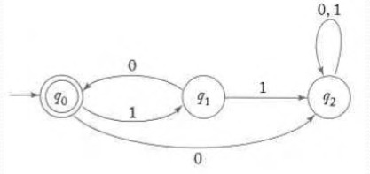
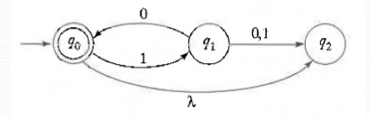
Equivalence of DFA and NFA
Theorem: Every language accepted by a nondeterministic finite acceptor can be represented with deterministic finite acceptor
Are these to FAs equivalent?
{(10) ^{n}: n∈0 }
9

Slide 57
NFA to DFA
Example
Giving a NFA like this, turn it into a DFA
q₂
1
1
3
q₁
1
q₃
1
q₀
1
3
q₄
q₅
2
10

Slide 58
NFA to DFA
q₂
1
1
3
q₁
1
q₃
NFA
1
q₀
1
3
q₄
q₅
2
1
q₂ q₃ q₅
DFA
q₁ q₄
3
2
q₀
q₅
11

Slide 59
Outline
Formal Definition of NFA
Recognizing Languages
Equivalence of DFA and NFA
Procedure: NFA-to-DFA
12

